Slide 1


Slide 2
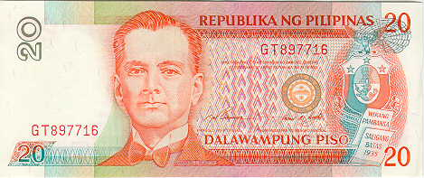
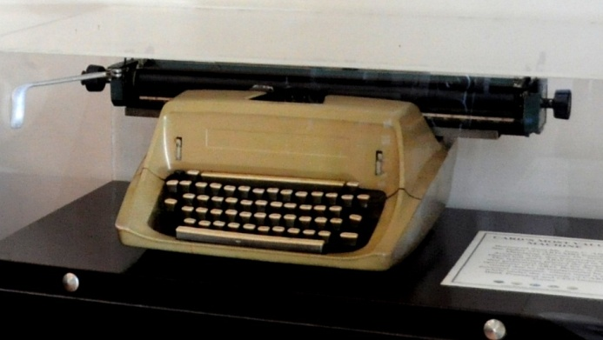
CARD Mutually Reinforcing Institutions
CARD was established on December 1986 with only a 20 peso bill and an old typewriter. After thirty years, CARD has grown into a group of
21 mutually reinforcing institutions driven by its passion to eradicate poverty.

Slide 3

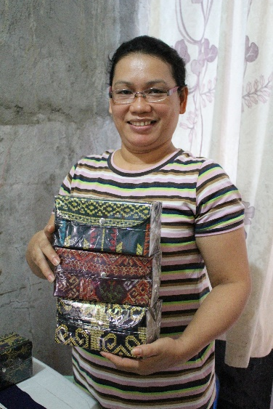
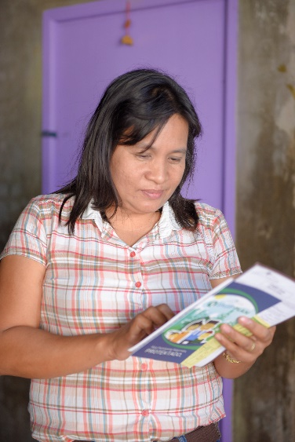
Vision
CARD MRI is a world-class leader in microfinance and community-based social development undertakings that improve the quality of life of socially-and-
economically challenged women and families towards nation building.

Slide 4
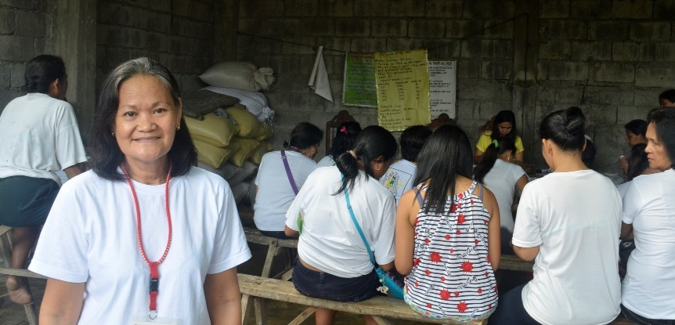
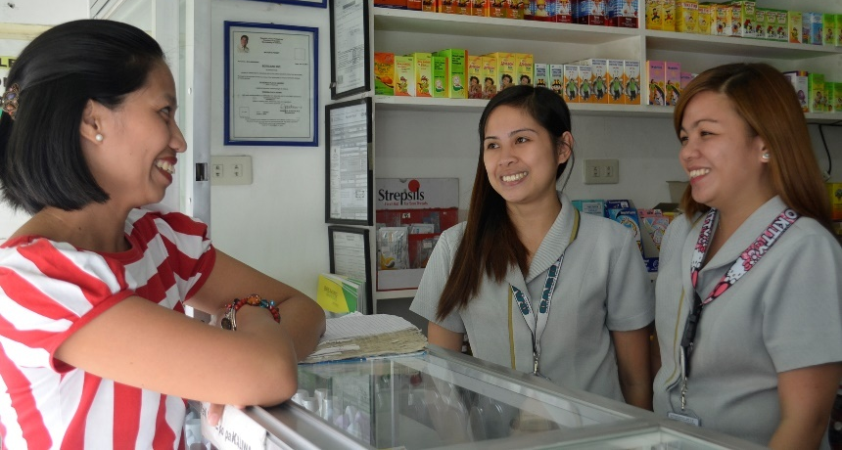
Mission
CARD MRI is committed to:
Empower socially-and-economically challenged women and families through continuous access to financial, micro insurance, educational, livelihood, health, and other capacity-building services that eventually transform them into responsible citizens for their community and environment;
Enable the women members to gain control and ownership of financial and social development enterprises; and
Partner with appropriate government agencies, private institutions, and people and community organizations to facilitate achievement of mutual goals.

Slide 5

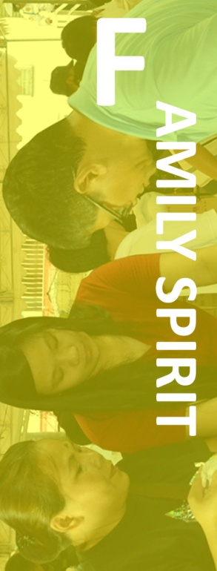





Our Values
In fulfilling our mission, we are guided by the highest standards of ethical behavior and the core values of:

Slide 6
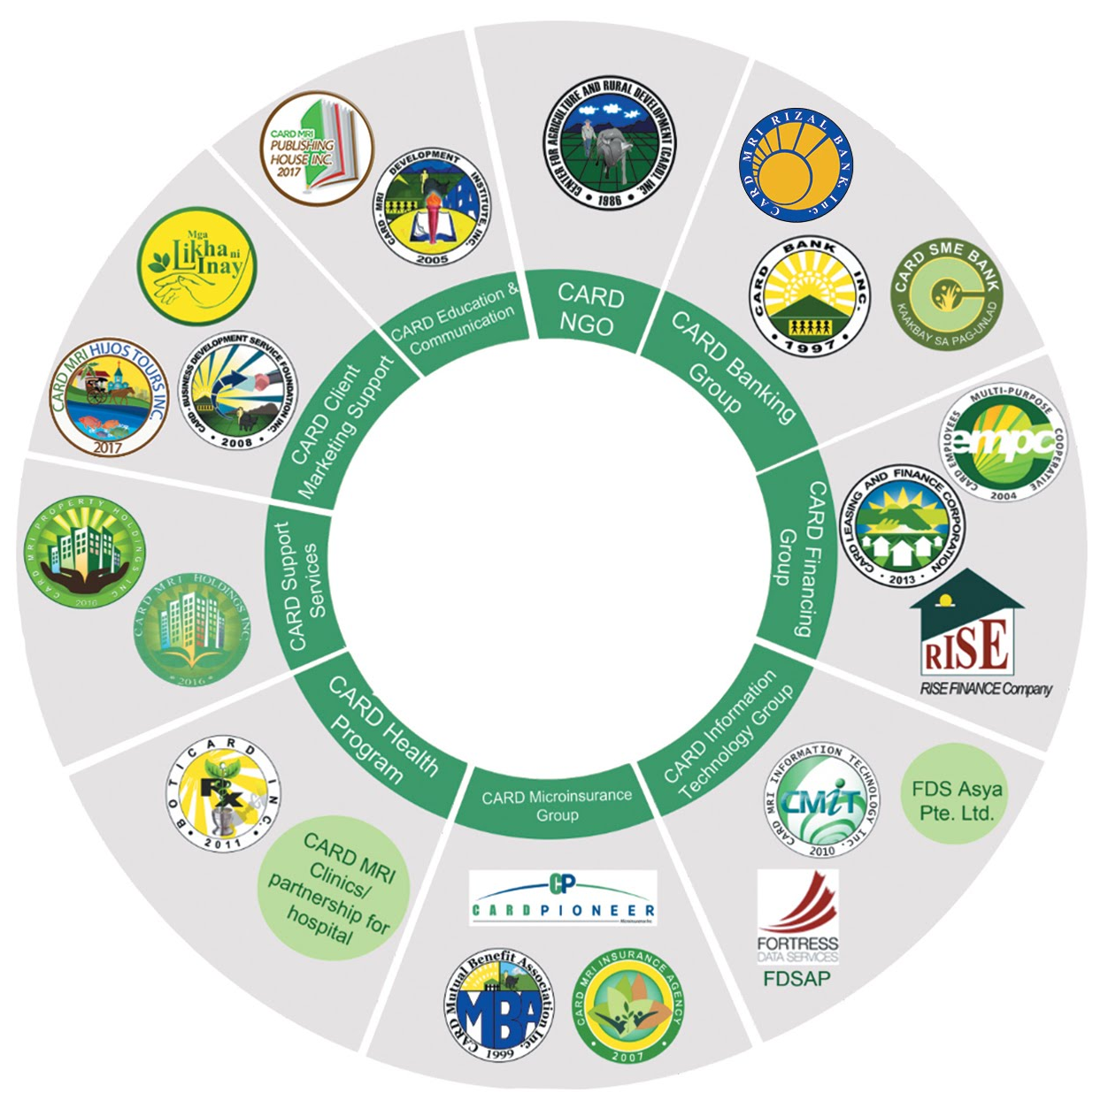
CARD MRI
Organigram
The CARD Mutually Reinforcing Institutions

Slide 7

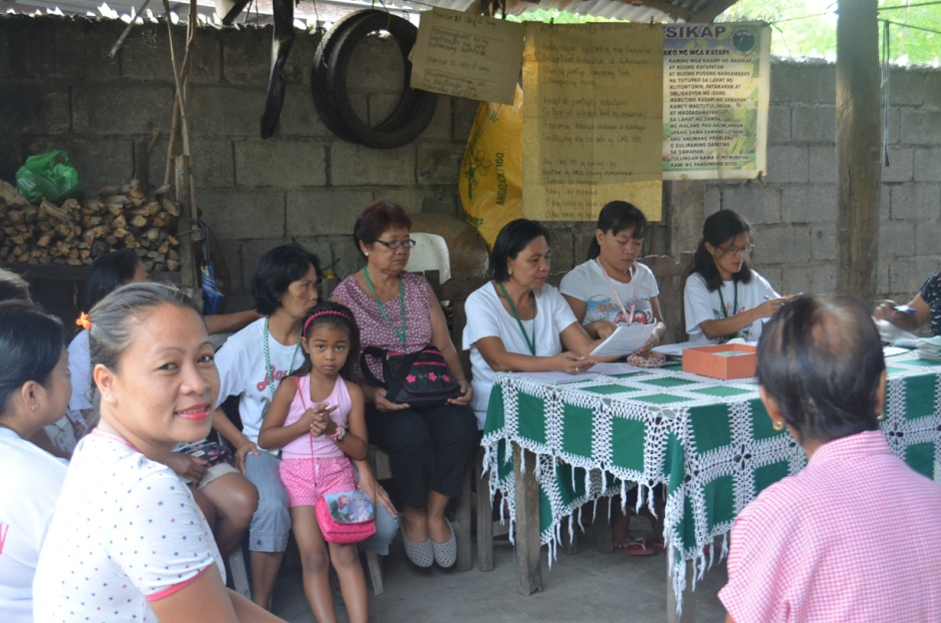
The 21 Mutually Reinforcing Institutions
Center for Agriculture and Rural Development (CARD), Inc.
CARD, Inc. has now grown into one of the country’s major pillars in the microfinance industry. It offers microloans to support the livelihood activities of poor women. It also initiates CARD MRI’s programs in education, health, and agriculture.
PRODUCTS AND SERVICES: Microfinance loans and community development services in agriculture, health, and education

Slide 8



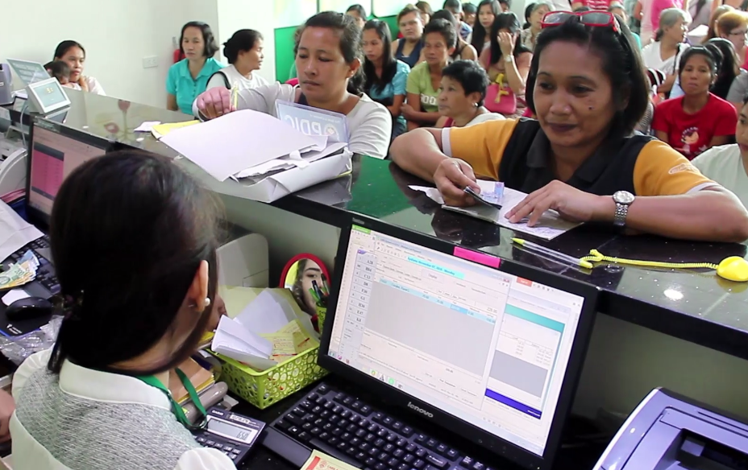
The 21 Mutually Reinforcing Institutions
CARD Banking Group
The CARD Banking Group evolved with the purpose of turning poor women who were once considered non-bankable, to be financially inclusive. It also gives qualified members a chance to gain ownership of the bank. It offers loans and savings products tailored fit to the needs of microfinance and SME clients.
PRODUCTS AND SERVICES: Loans, Savings, and Remittance

Slide 9



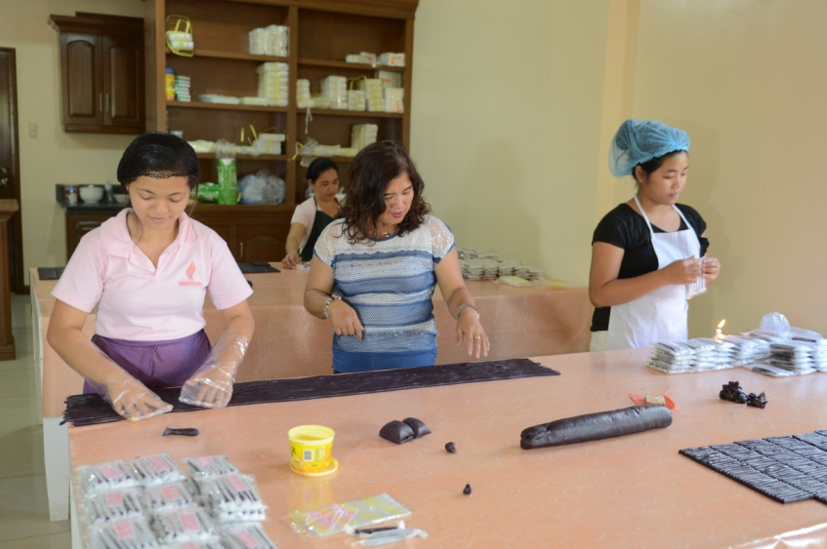
The 21 Mutually Reinforcing Institutions
CARD Financing Group
The CARD Financing Group engages in financing and leasing activities to support the needs of CARD MRI staff, clients, and even the general public to increase efficiency and effectivity in the services they provide.
PRODUCTS AND SERVICES: Financing, printing, financial and operating lease, lending services to microfinance and educational institutions

Slide 10
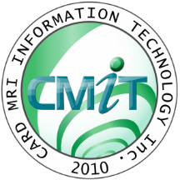

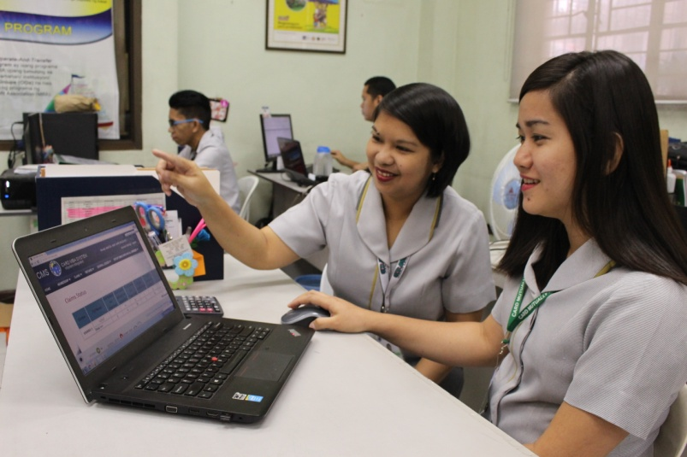
The 21 Mutually Reinforcing Institutions
FDS Asya
Pte. Ltd.
CARD Information Technology Group
The CARD Information Technology Group provides a customized Information Communications Technology for the microfinance industry. Currently, it offers software development, hardware maintenance, web design, and technical assistance to CARD MRI group.
PRODUCTS AND SERVICES: Information technology in the context of poverty eradication

Slide 11

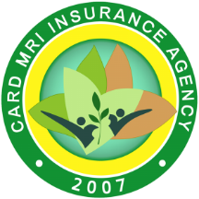
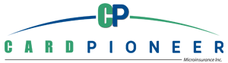
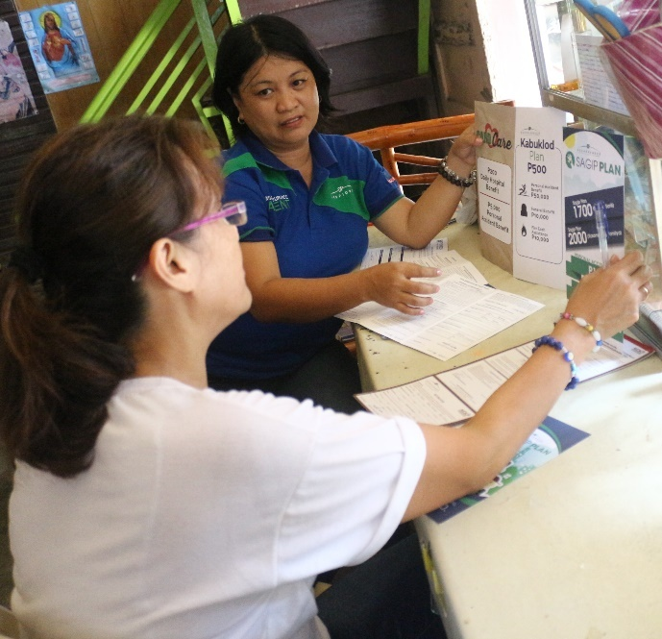
The 21 Mutually Reinforcing Institutions
CARD Microinsurance Group
The CARD Mutual Benefit Association covers the life insurance of the CARD MRI members while CaMIA and CPMI delivers affordable life and non-life insurance products and services to help members get back on their feet after any calamity.
PRODUCTS AND SERVICES: Life and non-life insurance; CARD MRI Disaster Relief Assistance Program; Mass Wedding

Slide 12
Microinsurance At-A-Glance
Claims Payment as of December 2019
Particulars | No. of Claims | Amount of Claims Paid (Php)
Total claims paid (including paid donations) | 1,404,386.00 | 2,177,645,613.66
CARD MRI Disaster Relief Assistance Program (CDRAP) | 553,957 | 39,839,372.75
Mass Wedding | 46 | 45,500.00

Slide 13
CaMIA At-A-Glance
Enrolment and Claims Payment as of December 2019
Particulars | No. | Amount (Php)
SAGIP Plan Sales | 546,178 | 847,769,432.89
KABUKLOD Plan Sales | 594,247 | 297,123,500.00
DAKILA Plan Sales | 44,180 | 24,779,997.40
CARD CARE Sales | 862,836 | 214,793,267.84

Slide 14

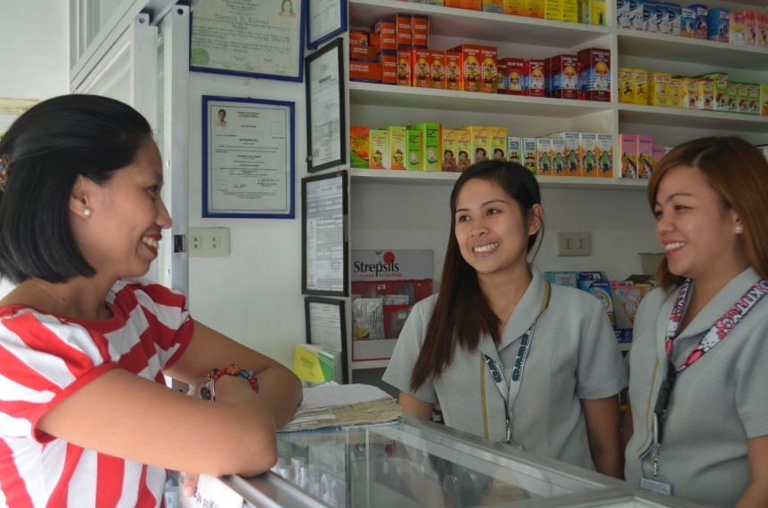
The 21 Mutually Reinforcing Institutions
CARD MRI Clinics/Partnership with Hospitals
CARD Health Program
CARD MRI Clinics and partner hospitals reach poor communities in the country to provide healthcare services to its clients and the communities it serves. Meanwhile, BotiCARD, the pharmacy of CARD MRI offers quality and affordable medicines.
PRODUCTS AND SERVICES: Laboratory examinations, healthcare services, medicines, health education

Slide 15
BotiCARD At-A-Glance
No. of Clients Served | 1,056,039
No. of Employee | 32
Head Office | 1
Warehouse | 1
No. of Branches | 10
No. of Partners | 2

Slide 16

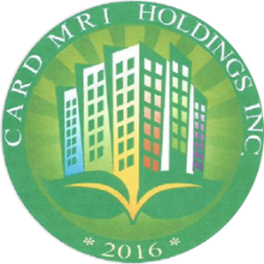
The 21 Mutually Reinforcing Institutions
CARD Support Services
CARD MRI Property Holdings and CARD MRI Holdings own assets and properties that the institutions under CARD MRI can use for the expansion of operations.
PRODUCTS AND SERVICES: Stocks, real estate, bonds, equity fund

Slide 17



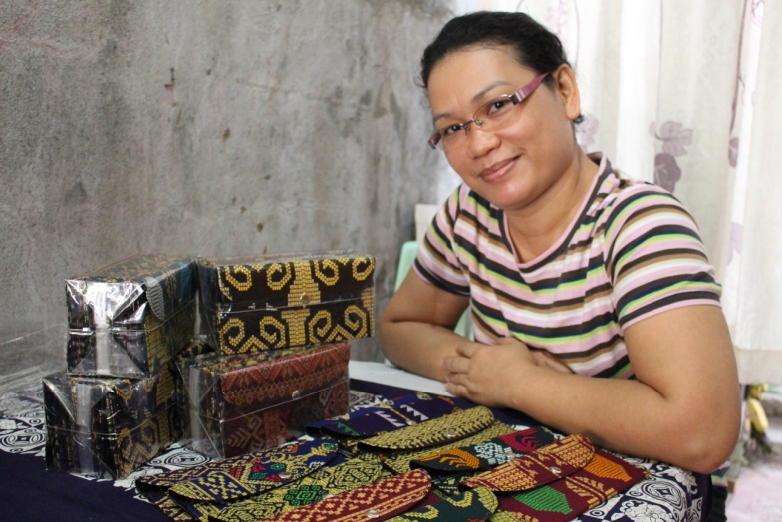
The 21 Mutually Reinforcing Institutions
CARD Client Marketing Support
CARD-Business Development Service Foundation and Mga Likha ni Inay provide business and product development to CARD clients and help their products to come into a wider market. CARD Hijos Tours, Inc. provides CARD MRI clients an opportunity to have another source of livelihood through its tours.
PRODUCTS AND SERVICES: Business development, marketing assistance, linkages, network, heritage tour

Slide 18


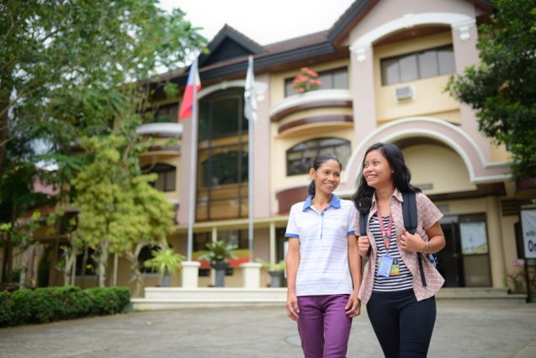
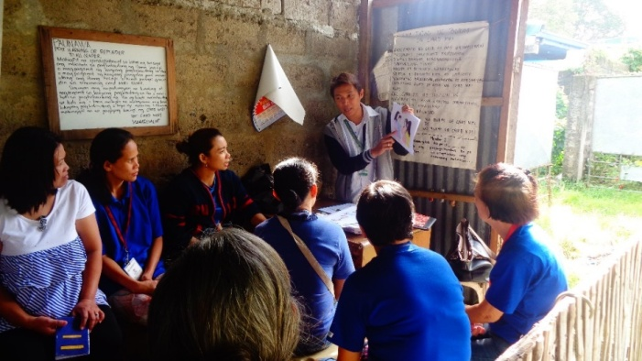
The 21 Mutually Reinforcing Institutions
CARD Education and Communication
CARD-MRI Development Institute commits to equip CARD MRI staff, clients, and its students with the competencies, values, and spirit to excel in achieving the mission of CARD MRI. It aims to produce one college graduate in every family it serves through its One Family, One Graduate Program. The CARD Publishing Company aims to propagate developmental stories of social awareness and social responsiveness to CARD MRI clients.
PRODUCTS AND SERVICES: Senior High School, Degree Courses, Scholarships, and training programs. Publications like Sulong

Slide 19
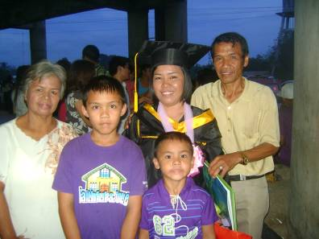
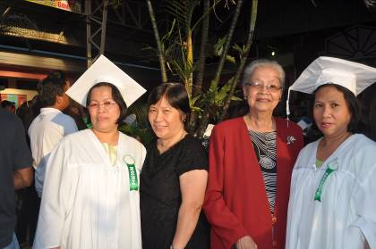
Community Development Programs
The goal of CARD MRI is to eradicate poverty in the Philippines and that is by providing not only microfinance services but also community development programs. The following are the community development programs of CARD MRI for its clients and their dependents and the general public:
Education Program:
“One Family, One Graduate”
CARD MRI Scholarship Program (CSP) for members’ children
Balik-Eskwela si Nanay (scholarship for members)
Zero Dropout Loan Program
UP Education Loan Project

Slide 20
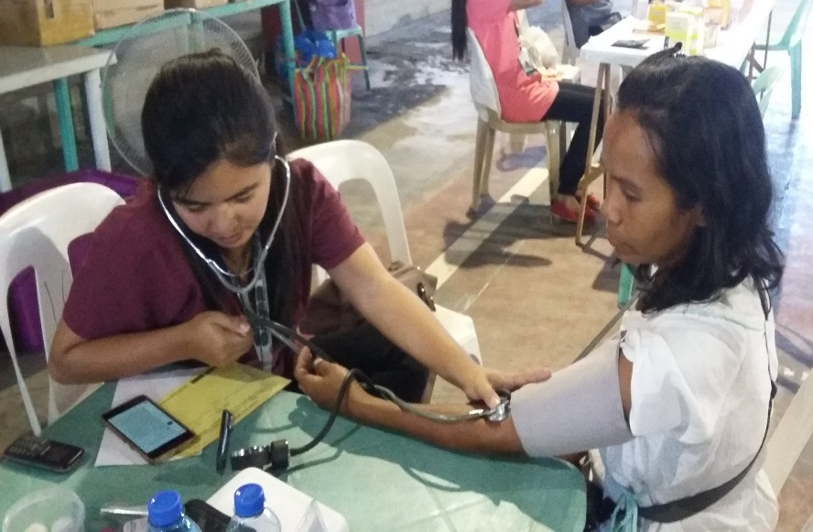
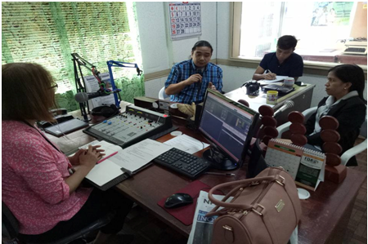
Community Development Programs
Health Program
In eradicating poverty, we must also eradicate possible causes of health problems. Through the Microfinance and Health Protection Program (MaHP), CARD MRI contributes to the communities by providing access to health services bringing medical practitioners closer to the economically-challenged so that they can avail quality services for free or at a reasonably low price.
MaHP also works in close coordination with BotiCARD Inc., CARD MRI’s Generic Pharmacy, to provide our members, staff, and the general public with affordable and quality medicines.

Slide 21
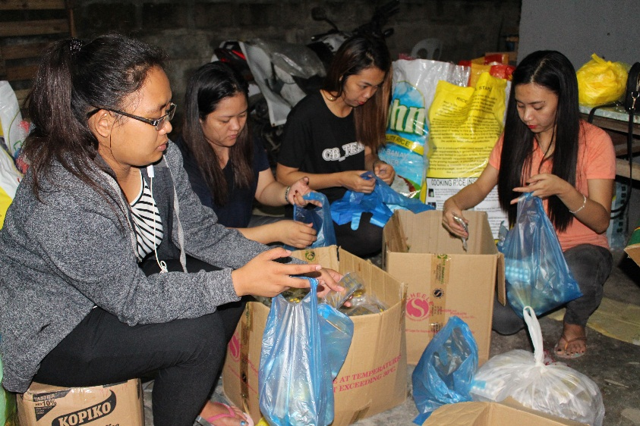
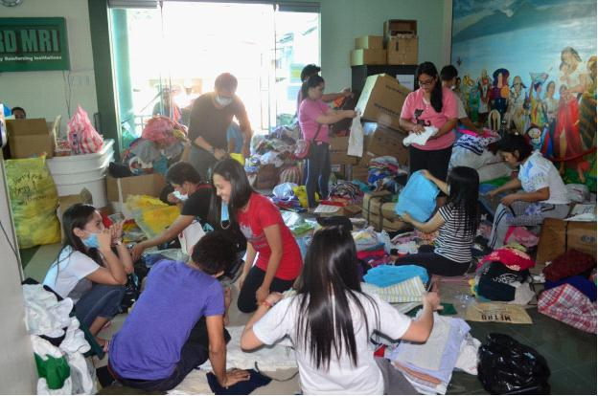
Community Development Programs
Disaster Management Program
Through the CARD MRI Disaster Relief Assistance Program (CDRAP), clients and staff are provided with relief assistance in times of disaster.
To date, more than 1.5 million families nationwide have been assisted through CARD MRI’s relief operations.

Slide 22
CARD MRI At-a-Glance
As of December 2019
Number of Clients Served: 7,010,778
Number of Insured Individuals: 26,952,125
Clients (Incl. Savers): 6,532,402 Staffing: 19,089
Loan Clients: 3,499,471 Clients with CwE: 1,333,428
Loan Outstanding: 30,159,227,545 Number of member stockholders: 121,924
Savings: 24,338,696,493 Scholarships granted: 15,756
Repayment Rate: 99.21% Graduate Scholars: 8,207
Operational Sufficiency: 133.66% With access to health: 4,595,960
Financial Sufficiency: 122.92% No. of clinic visits: 549,976
Offices: 3,673 Families, relief operations: 781,334

Slide 23
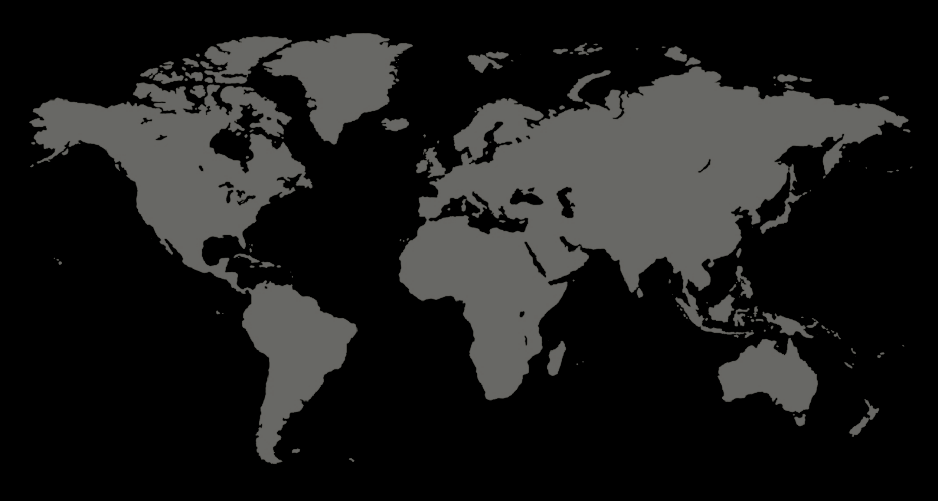
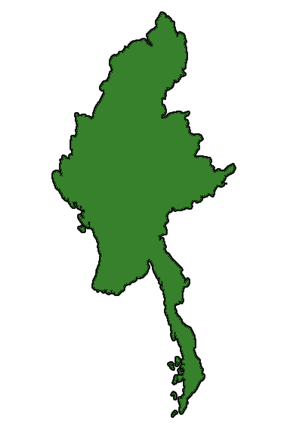
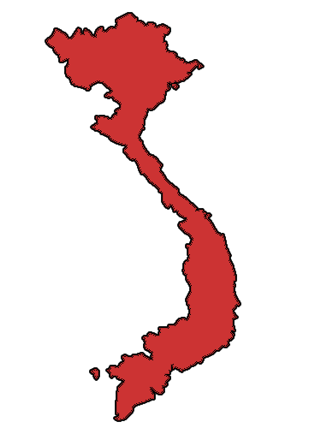
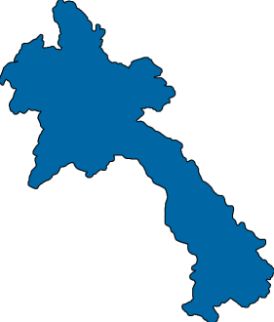

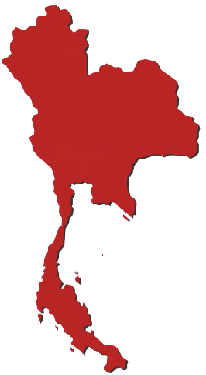
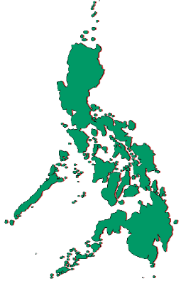
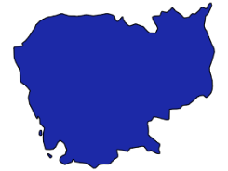
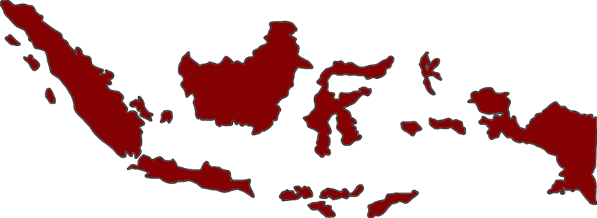
Geographical presence of
CARD MRI
Myanmar
Hong Kong
CARD MRI started a partnership program in Myanmar in 2012 and a microfinance operation in 2014.
Vietnam
CARD MRI established a partnership program in Hong Kong since 2007.
CARD MRI established a partnership program with TYM in Vietnam since 2005.
Philippines
Laos
CARD MRI opened again its international NGO office in Laos in 2009.
Today, CARD MRI has 3,673 offices all over the country, covering all 82 provinces, 96% (1,570) of cities/ municipalities and 97% (40,425) of barangays, since 1986 .
Cambodia
In year 2006, CARD MRI opened its first international NGO office in Cambodia.
Thailand
Partnership was executed in October 2017.
Indonesia
CARD MRI established a partnership program in Indonesia since 2008.

Slide 24
The CARD MRI Business Model
CARD, Inc. serves as the trailblazer.
CARD Bank and RBI absorb CARD, Inc. branches once viable and the license has been approved by BSP.
CARD SME Bank absorbs graduate clients to assist them with bigger capitals.
CARD MBA provides microinsurance to client in terms of life, loan, and retirement fund. CaMIA and CPMI on the other hand, provide also life and non-life insurance.
CMDI is the school of CARD MRI while CMIT, FDS Asya Philipines, and FDS Asya Pte. Ltd. handle technical support (products and services, accounts, employee records). CARD Publishing Company provides necessary information that could help CARD MRI clients and the public through different publications.
CARD-BDSFI and MLNI assist clients in marketing their products locally and internationally. CARD Hijos Tour Company is an avenue for CARD MRI clients to have extra income-generating activities.
BotiCARD pharmacy provides affordable and quality medicines as well as health protection program together with CARD MRI’s health program. CARD MRI Clinics and partner hospitals are ready to provide quality and affordable healthcare services.
RISE and CARD LFC assists our clients by providing innovative business support through lending and financing.
CARD EMPC assists CARD MRI staff through financial assistance. CARD MRI Property Holdings and CARD MRI Holdings own assets and properties that the CARD MRI institutions can use for their operations.

Slide 25
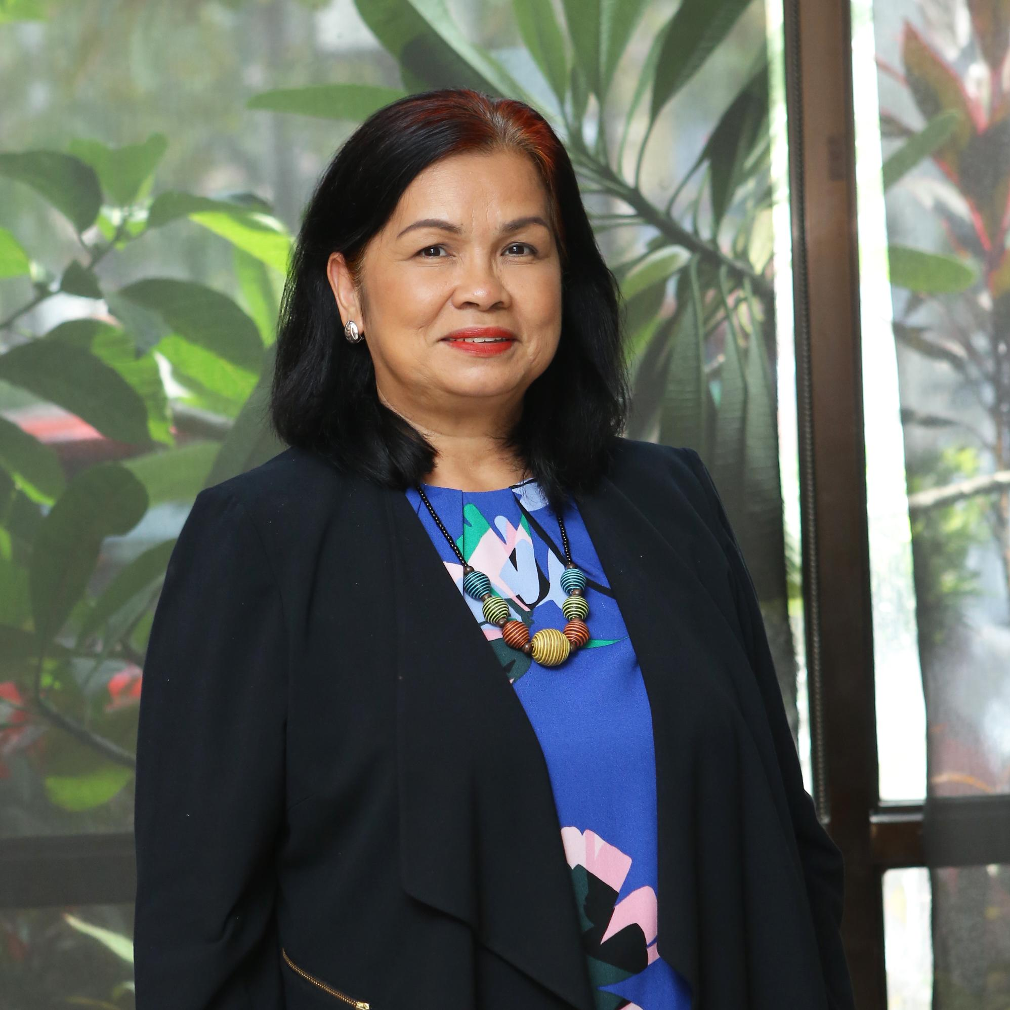
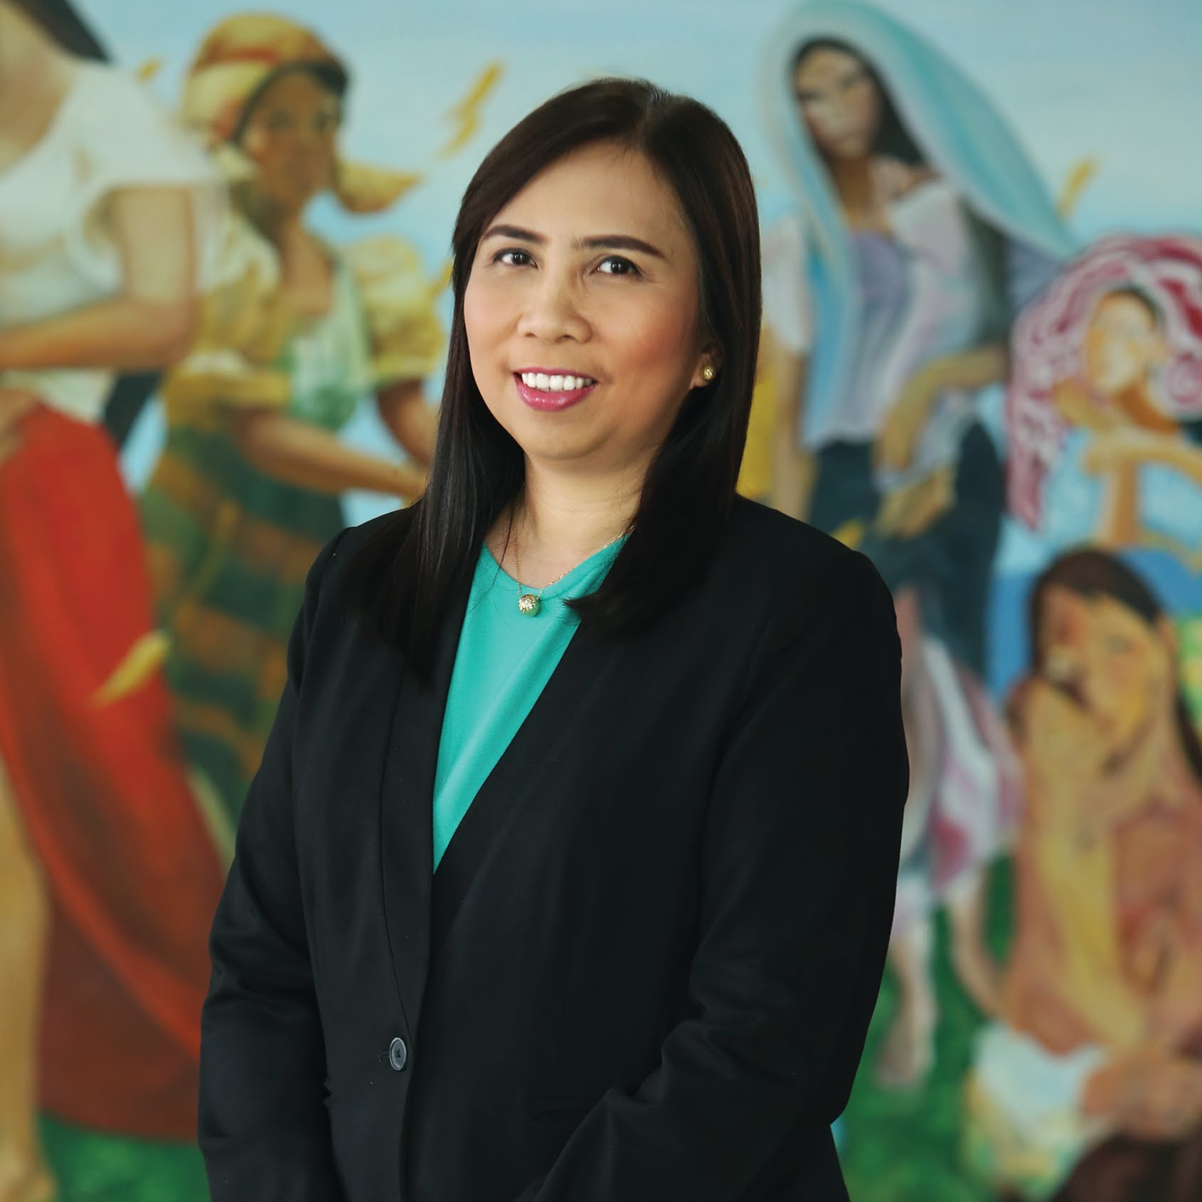
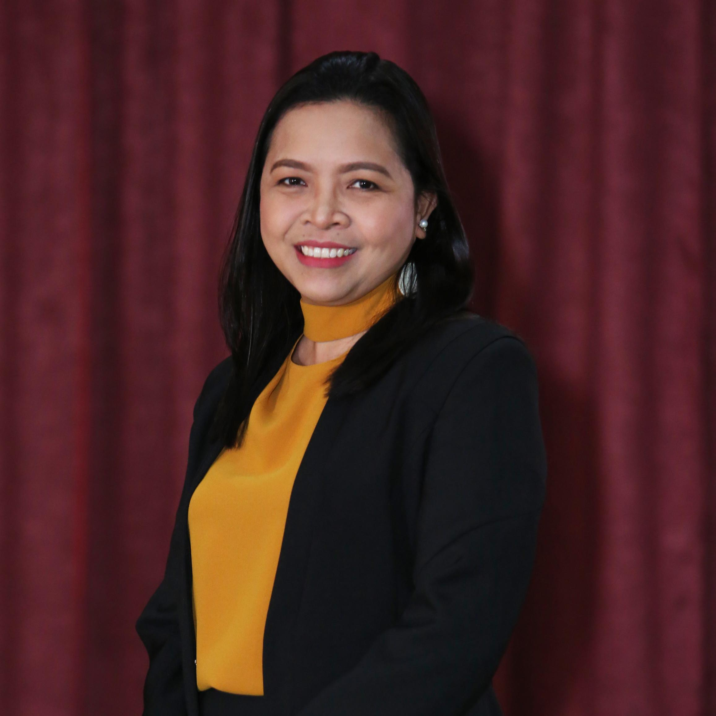
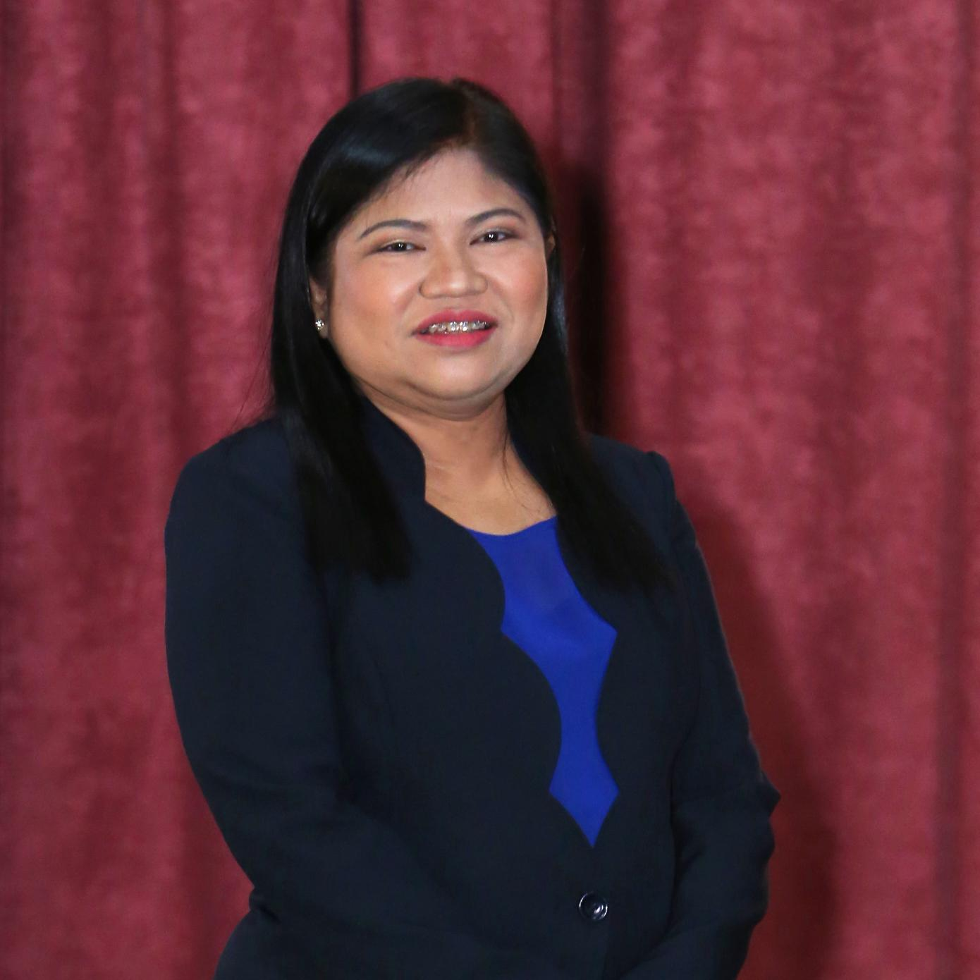
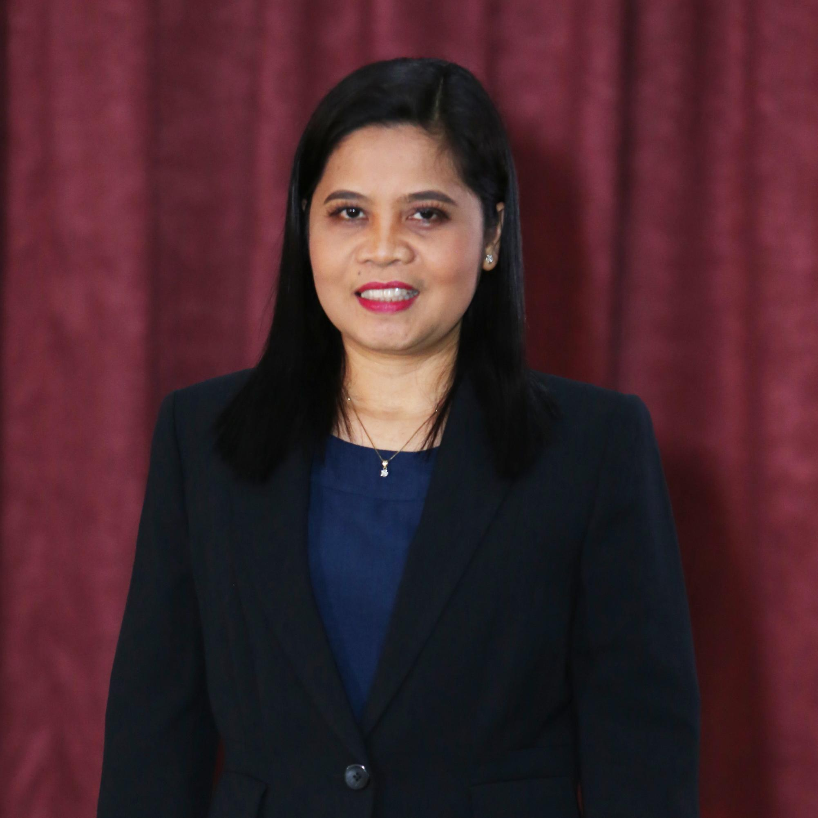
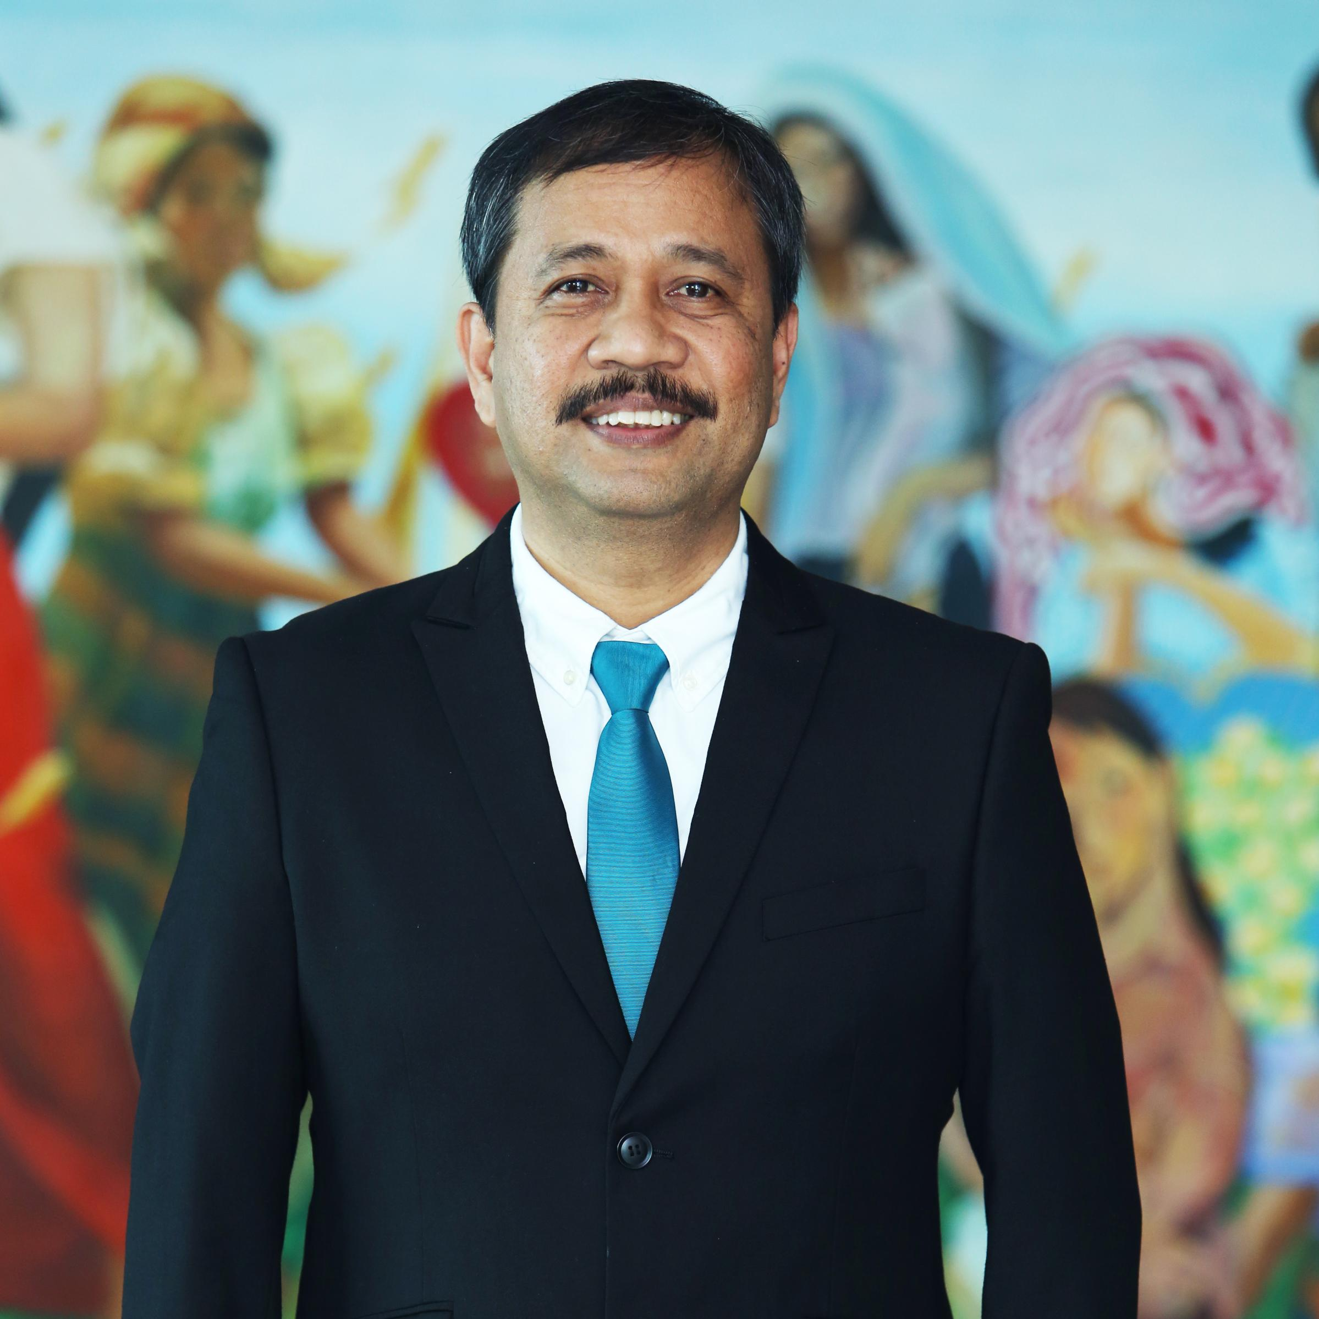
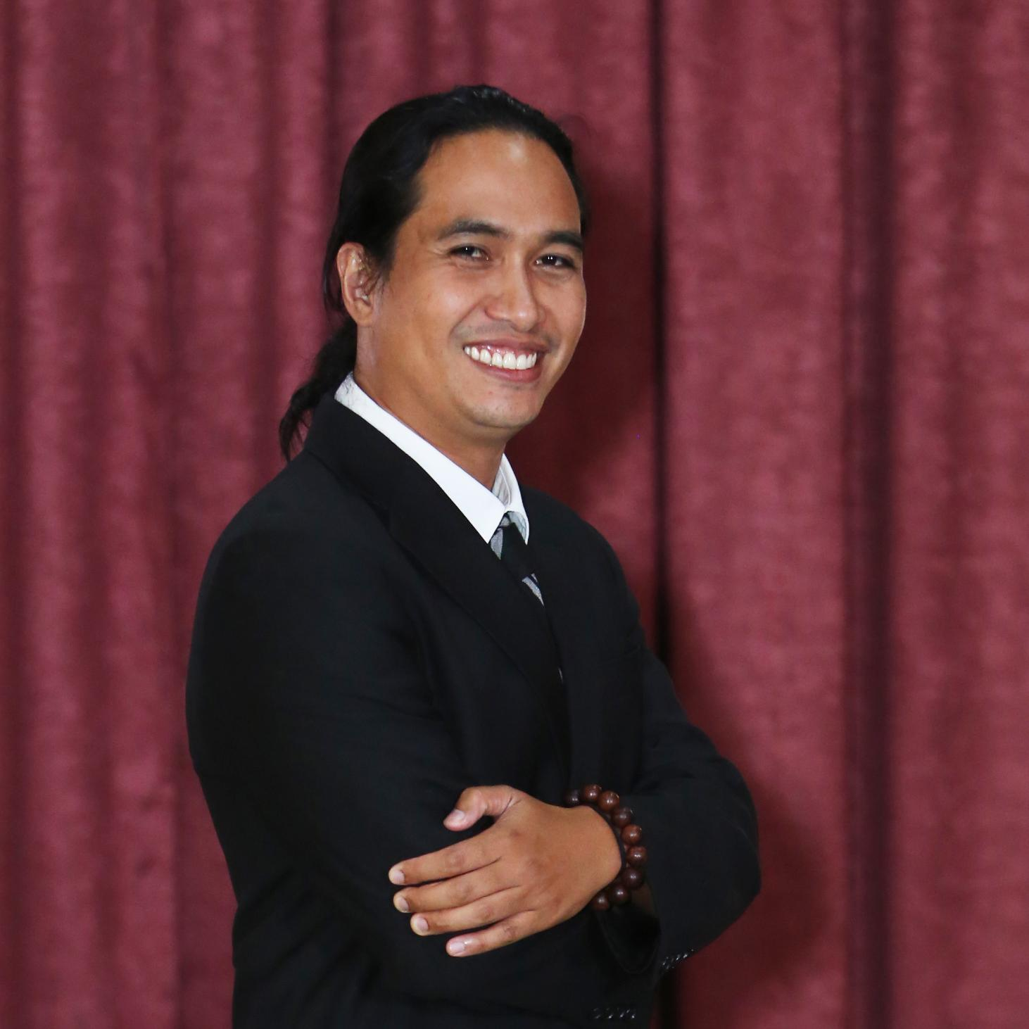
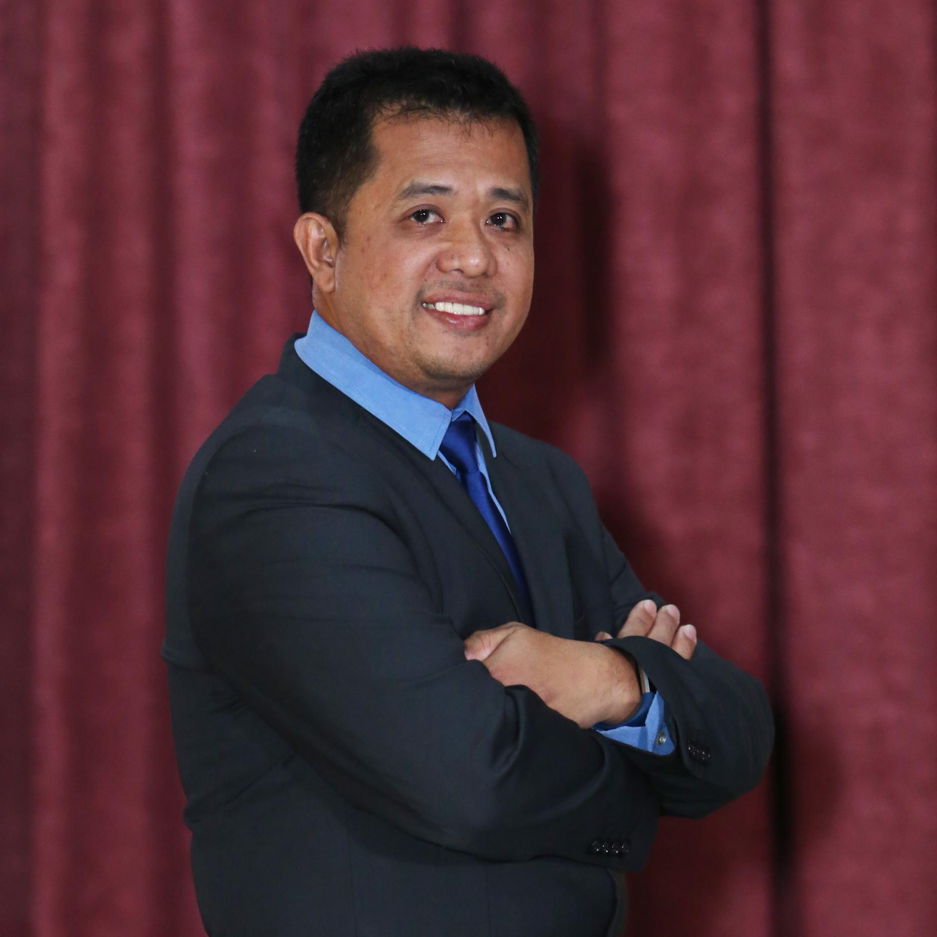
CARD MRI Institutional Heads
MS. FLORDELIZA L. SARMIENTO
Managing Director/President
CARD MRI/CMDI
JOCELYN D. DEQUITO
Executive Director
CARD, Inc.
MARIVIC M. AUSTRIA
President and CEO
CARD Bank
MAY S. DAWAT
Chief Executive Officer/President
CARD MBA/ CARD MRI Holdings
ELMA B. VALENZUELA
President and CEO
RBI
ARISTEO A. DEQUITO
President and CEO
CARD SME BANK
JULIUS ADRIAN R. ALIP
President and CEO
CARD-BDSFI/CARD LFC/MLNI
EDGAR V. CAUYAN
President and CEO
CMIT

Slide 26
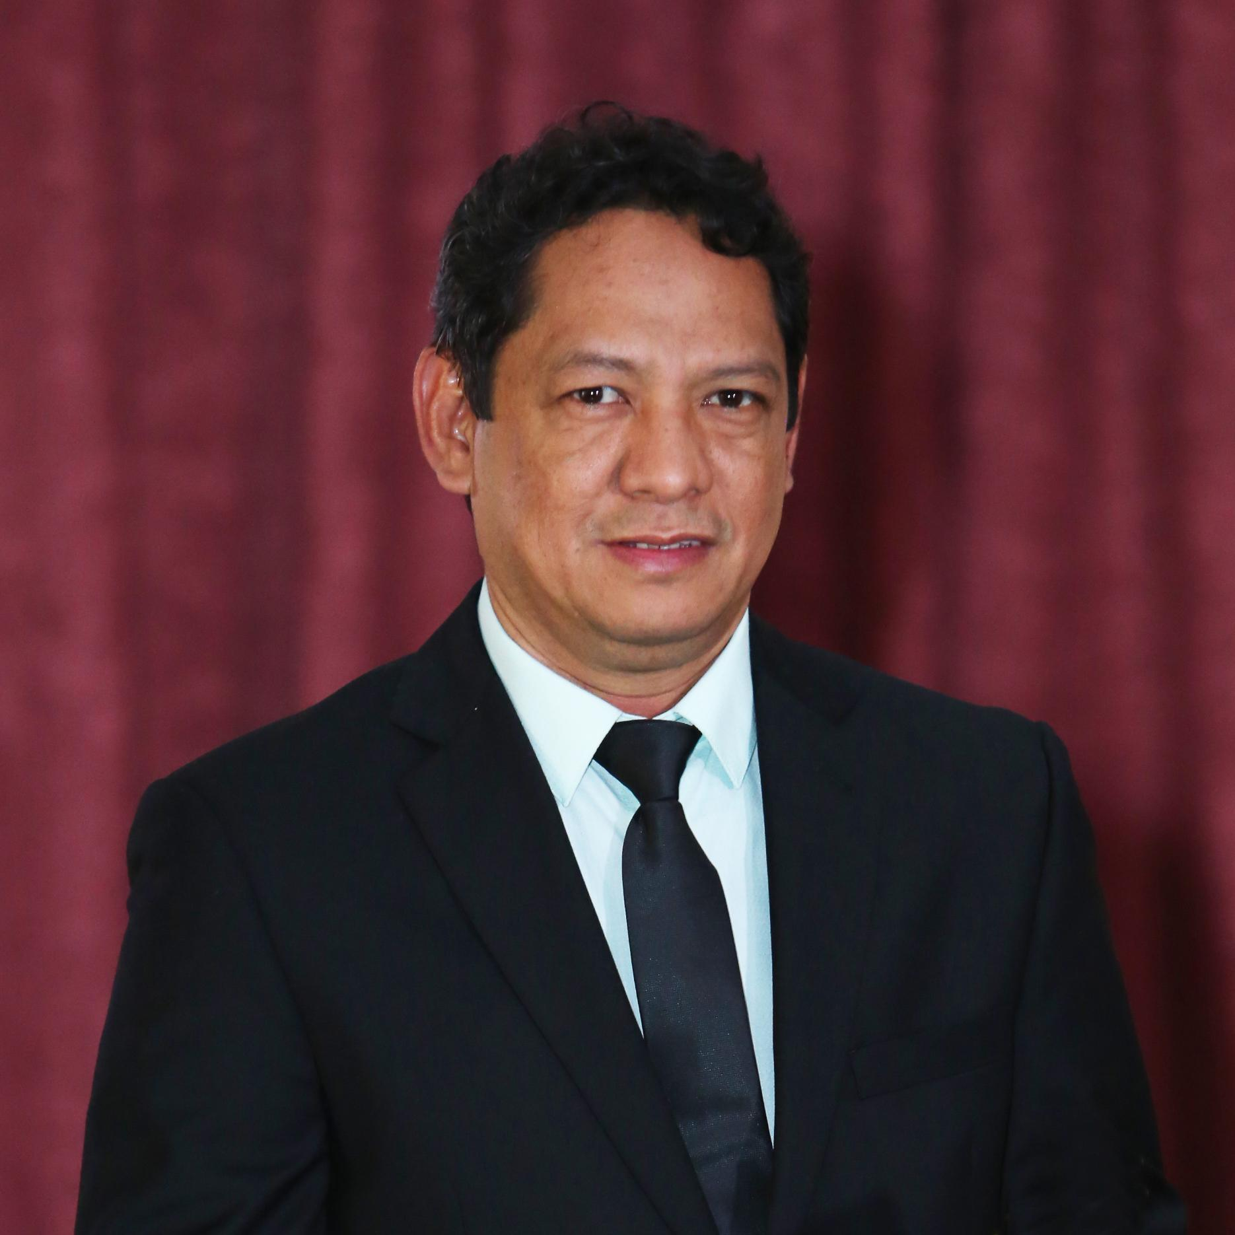
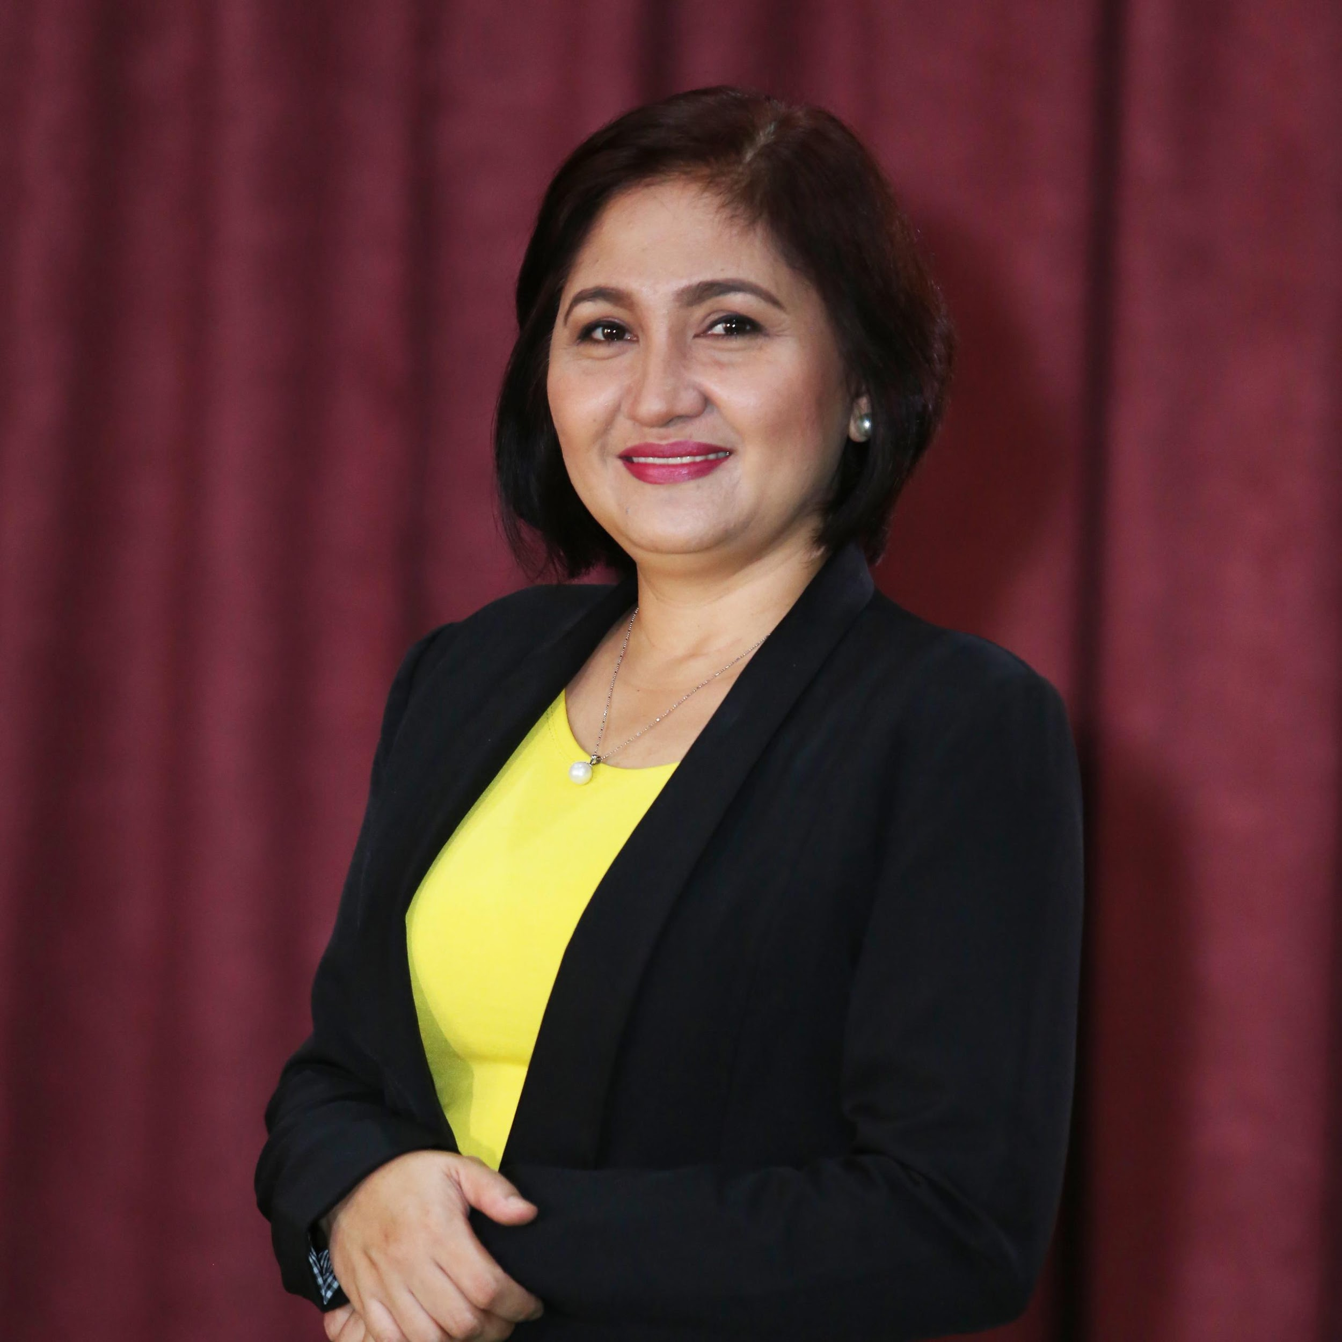
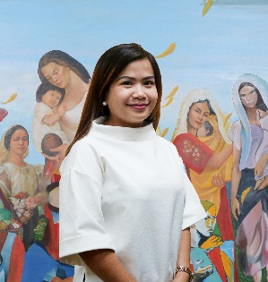
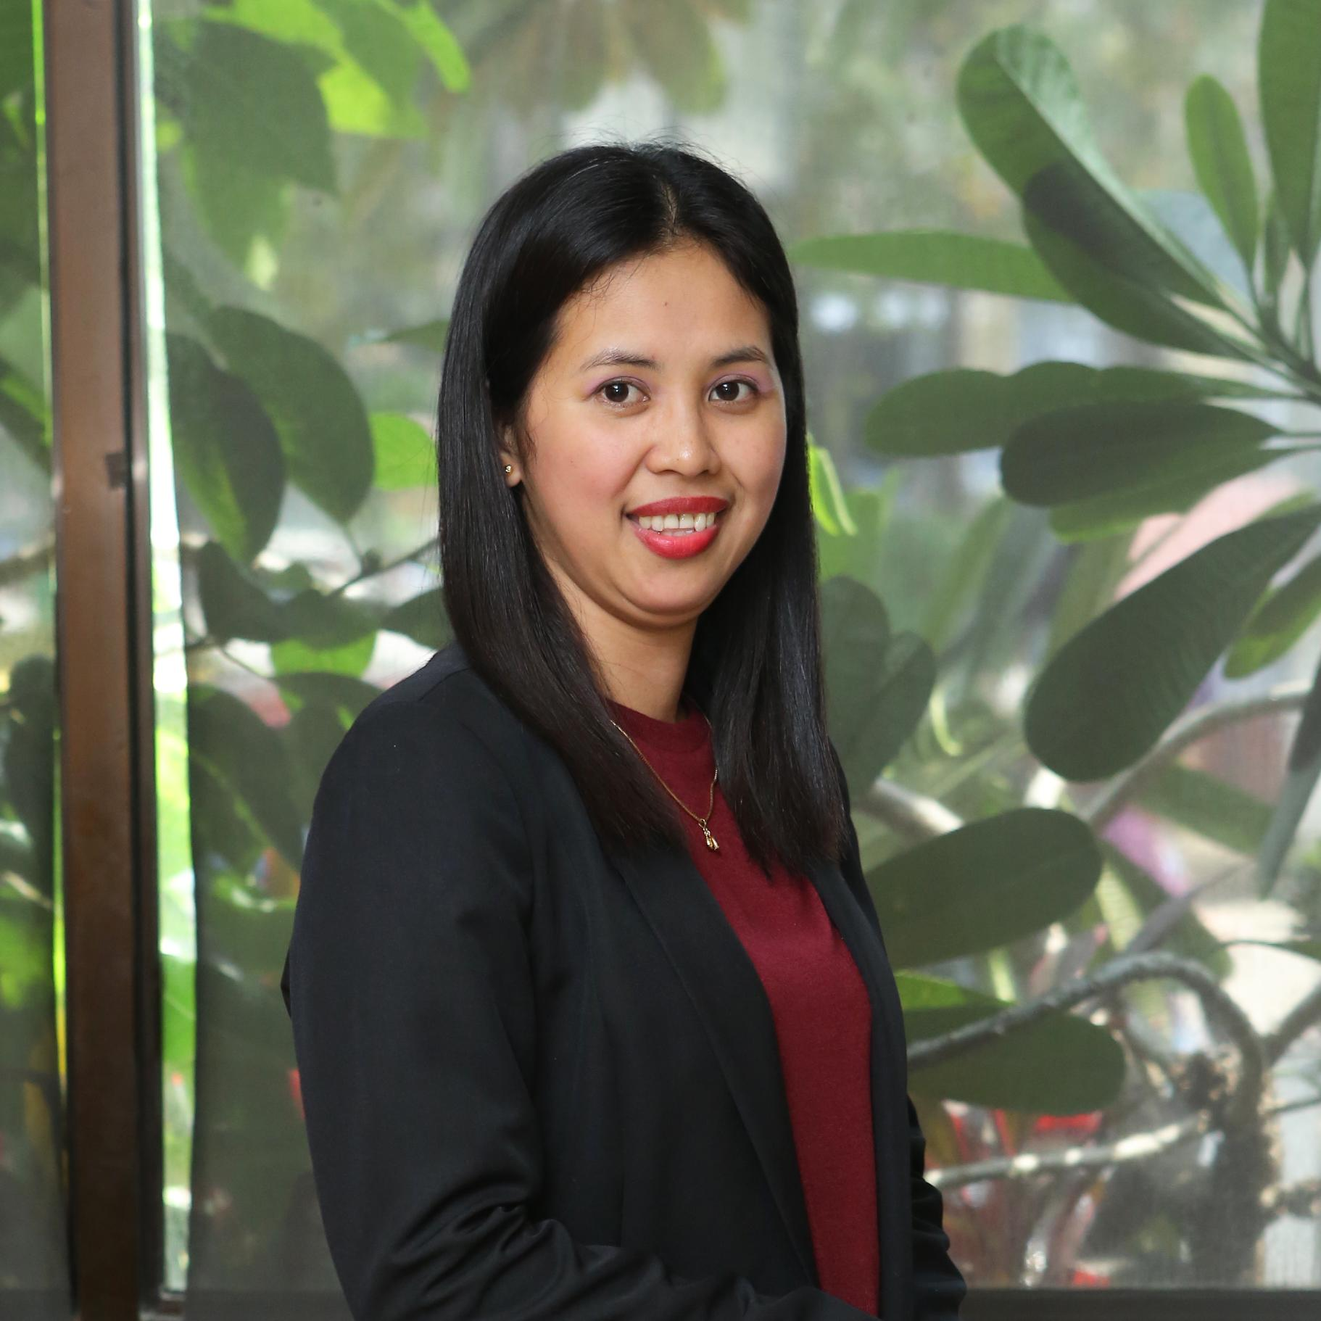
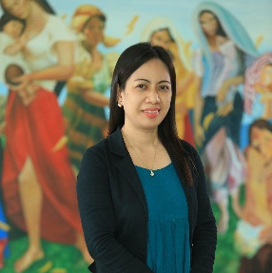


CARD MRI Institutional Heads
VENER S. ABELLERA
President and General Manager
CaMIA
ROSENDA P. AQUINO
President
BotiCARD
MELINDA GRACE M LABAO
Officer-in-Charge
CPMI
LOUSEL E. CORTES
President
RISE Company
LYNETH L. DEREQUITO
Chairperson and President / Director
CARD MRI Property Holdings / CARD MRI Support Group
MARILYN M. MANILA
President, CARD MRI Hijos Tours and CARD MRI Publishing House
NENIA I. PERALTA
General Manager
CARD EMPC

Slide 27
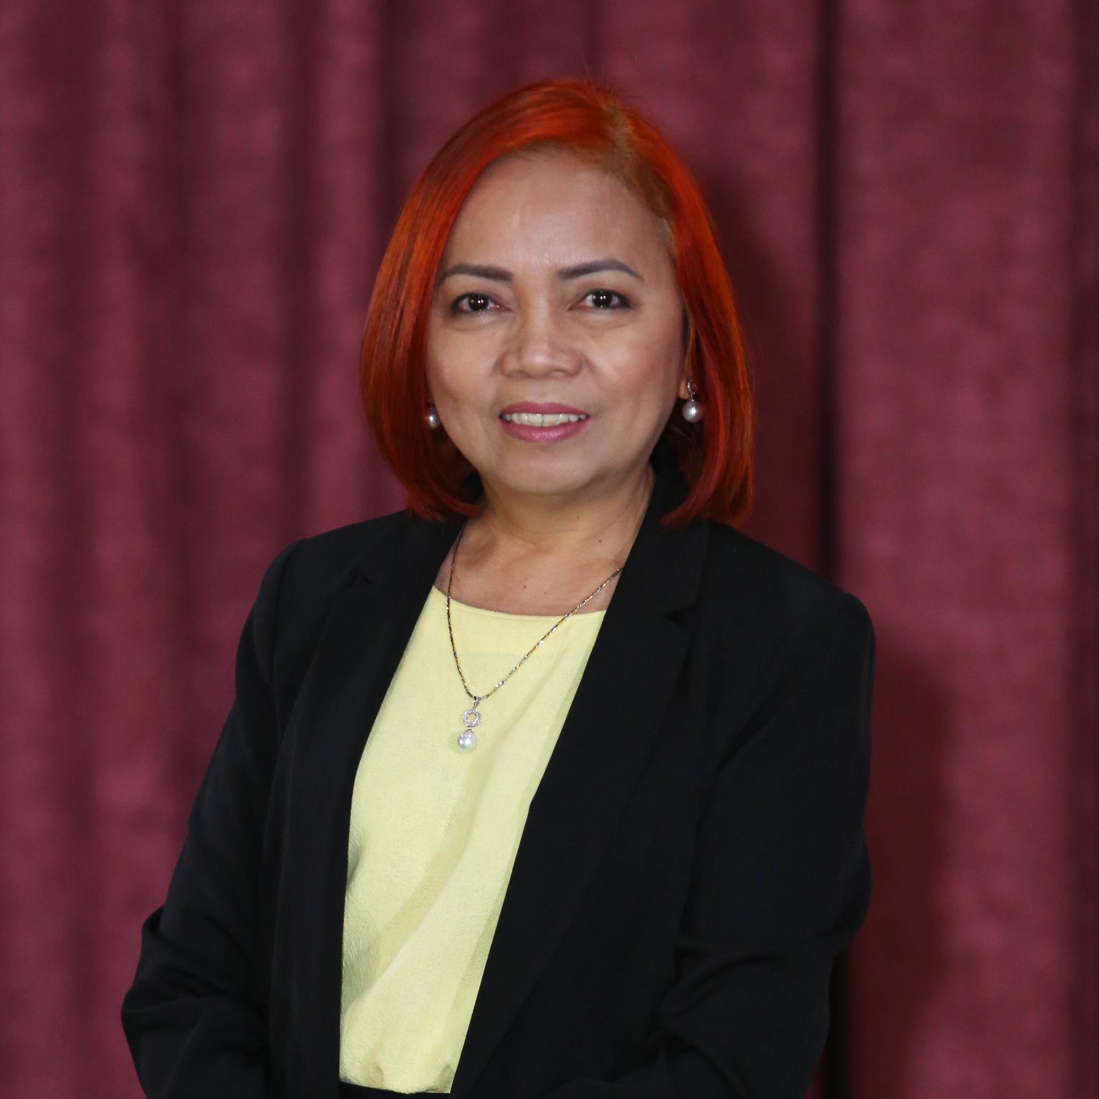
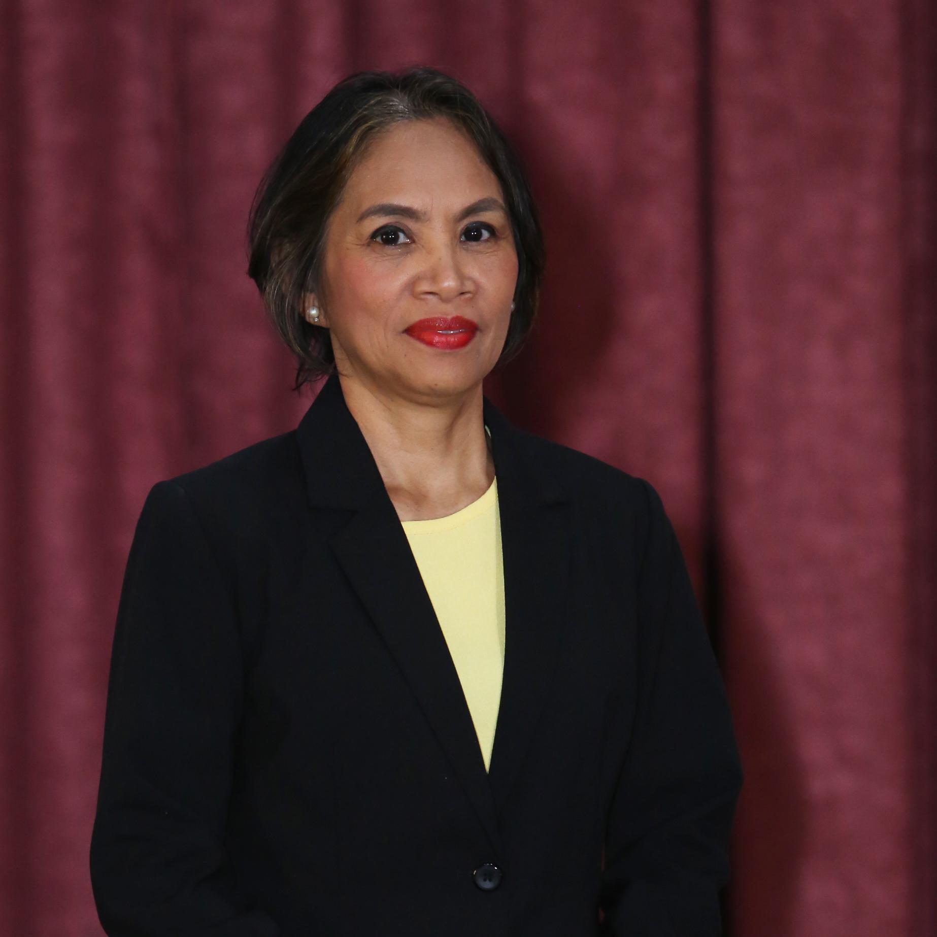




Other CARD MRI Executive Committee Members
LORENZA DT. BAÑEZ
Executive Vice President
CARD Bank
LOURDES B. DIJAN
Senior Vice President for Finance
CARD Bank
DR. EDZEL A. RAMOS
Executive Vice President
CMDI
DEVERNA dT. BRIONES
Vice President for Administration and Academic Affairs - CMDI
CYNTHIA B. BALDEO
Executive Vice President
CARD SME Bank
LAARNE D. PAJE
Vice President for Audit
CARD Bank

Slide 28






Management Advisers
DR. JAIME ARISTOTLE B. ALIP
Founder and Chairman
CARD MRI
DR. DOLORES M. TORRES
Senior Management Adviser/ Vice-Chairperson
CARD Bank
MS. MARY JEAN PERRERAS
Senior Management Adviser/
Vice-Chairperson
CARD SME Bank
DR. ENRIQUE S. NAVARRO
Senior Adviser
CMDI
MS. ANICETA ALIP
Research Adviser
CARD MRI
RAUL S. DIZON
Adviser
CMIT

Slide 29
Website
www.cardmri.com
Official Facebook page
CARD Mutually Reinforcing Institutions

Slide 30
Official Instagram account
@cardmri
Official Youtube channel
CARD MRI

